Slide 1

Object Oriented Programming
.net / Microsoft dynamics 365
https://docs.microsoft.com/en-us/dotnet/csharp/programming-guide/concepts/object-oriented-programming

Slide 2
Object-Oriented Programming (OOP) is a programming paradigm based on the concept of "objects", which can contain data, in the form of fields (attributes/properties), and code, in the form of procedures (methods). A feature of objects is an object’s methods. They can access and modify the data fields of their object. In OOP, computer programs are designed by making them out of objects (classes) that interact with one another.
https://en.wikipedia.org/wiki/Object-oriented_programming

Slide 3
Object-Oriented Programming – Four Pillars https://www.linkedin.com/pulse/4-pillars-object-oriented-programming-pushkar-kumar#:~:text=
The four pillars of OOP
Abstraction : The process of showing only essential/necessary features of an entity/object to the outside world and hide the other irrelevant information.
Encapsulation : Wrapping data and member functions (Methods) together into a single unit (class). Encapsulation automatically achieves the concept of data hiding. This provides security to data by making variables private and allowing public methods access to the private variables.
Inheritance : Creating a new class from an existing class template. A class (subclass) acquires the properties and behavior of a ‘base’ (‘super’) class.
Polymorphism: "many forms". A subclass can inherit functionalities or behavior of its parent/base class and define its own unique behavior.

Slide 4



Abstraction https://stackify.com/oop-concepts-c-sharp/#:~:text=
Abstraction is the process by which a developer hides everything other than the relevant data about an object in order to simplify and increase efficiency.
Abstraction in daily life
Apartment Building. We determine what the building is for by it’s exterior or sign but don’t know the specifics as to how the people live.
Factory.
Snail Mail.

Slide 5
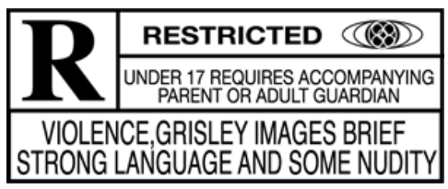
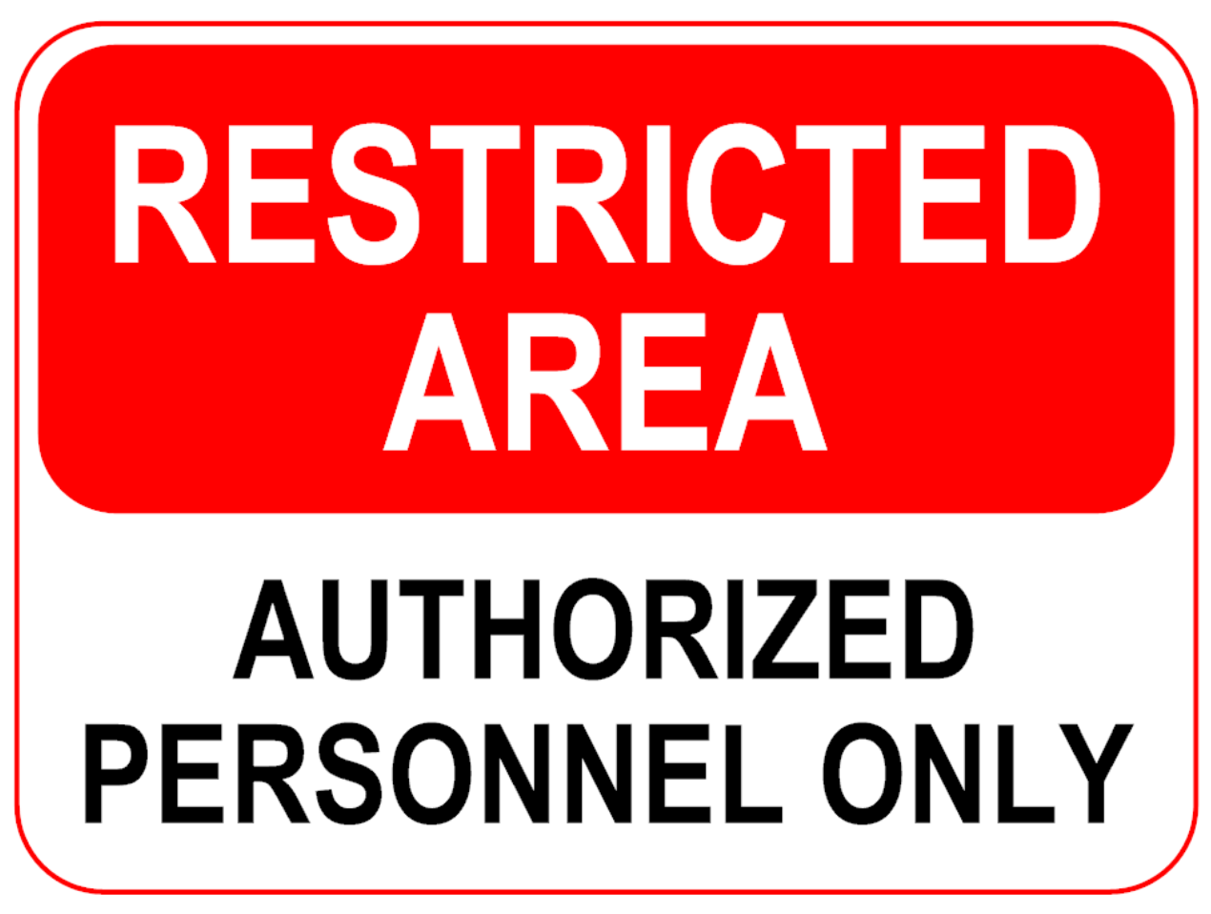
Encapsulation https://en.wikipedia.org/wiki/Encapsulation_(computer_programming)
Encapsulation the restricting of direct access to abstracted data.
Encapsulation prevents unauthorized parties' direct access to the members of a class. Publicly accessible methods are generally provided in the class (so-called "getters" and "setters") to access the values.

Slide 6



Inheritance https://docs.microsoft.com/en-us/dotnet/csharp/tutorials/inheritance#:~:text=
Inheritance allows you to define a child class that reuses (inherits) the characteristics of a parent class.
The class that Inherits the members of the ‘base’ class is called the ’derived’ class.
structs, delegates, and enums do not support inheritance.

Slide 7
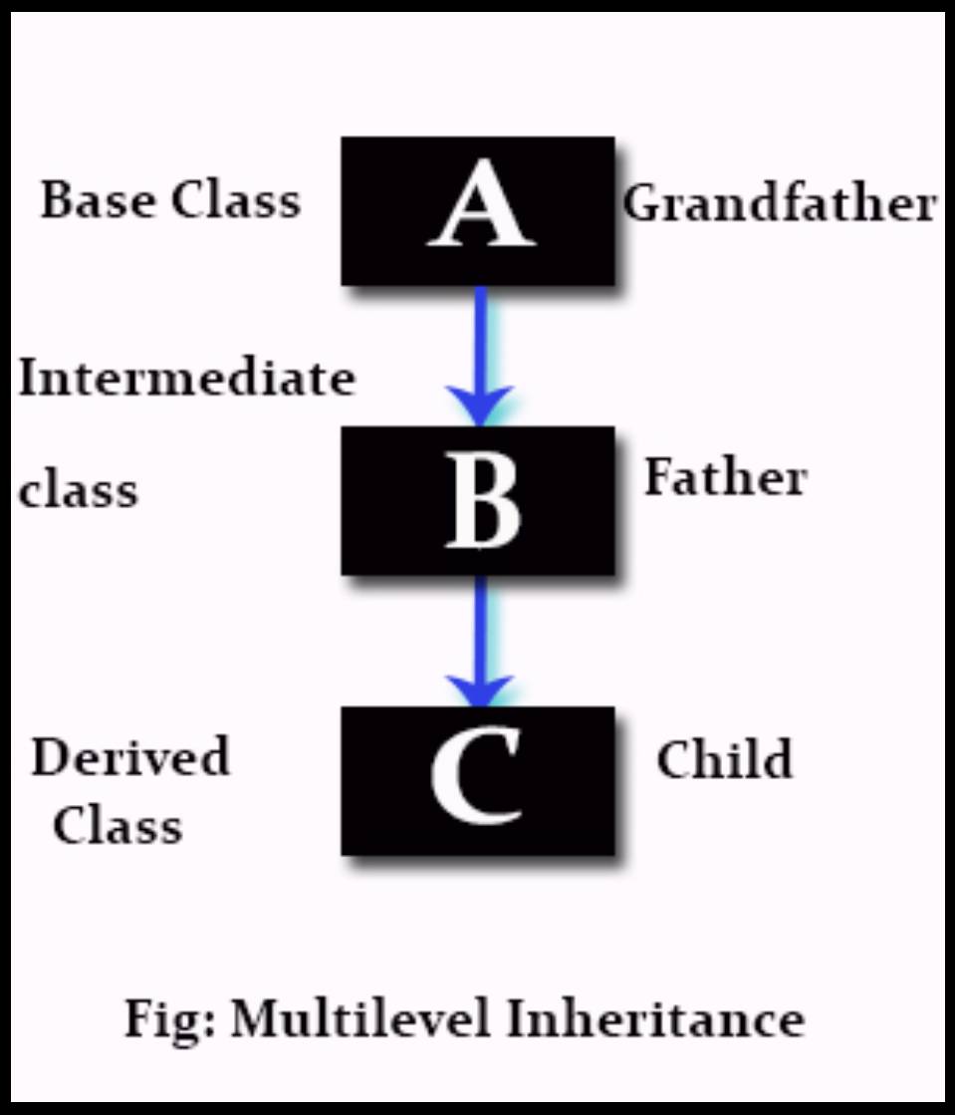
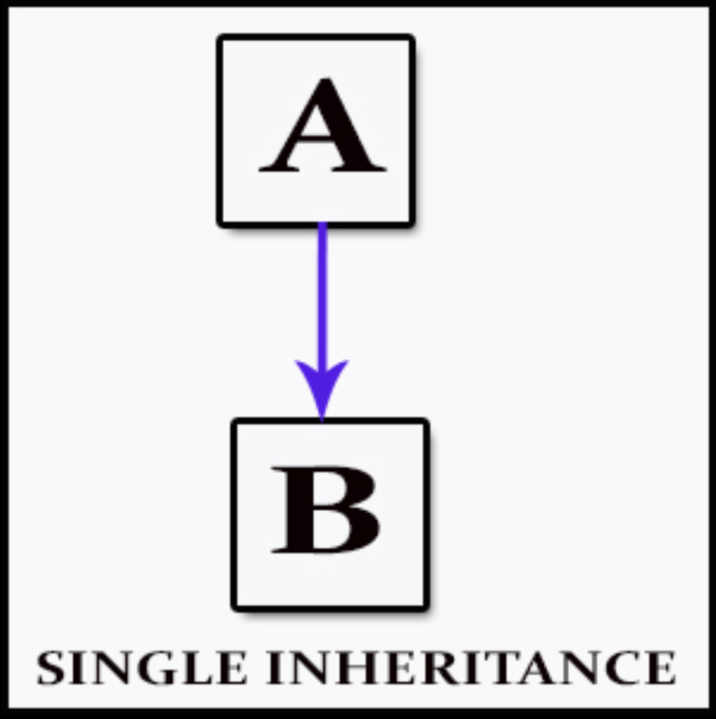
Inheritance - Types https://stackify.com/oop-concepts-c-sharp/#:~:text= https://en.wikipedia.org/wiki/Inheritance_(object-oriented_programming)
Single inheritance(C#) - where subclasses inherit the features of one superclass. A class acquires the properties of another class.
Multilevel inheritance(C#) - where a subclass is inherited from another subclass.

Slide 8
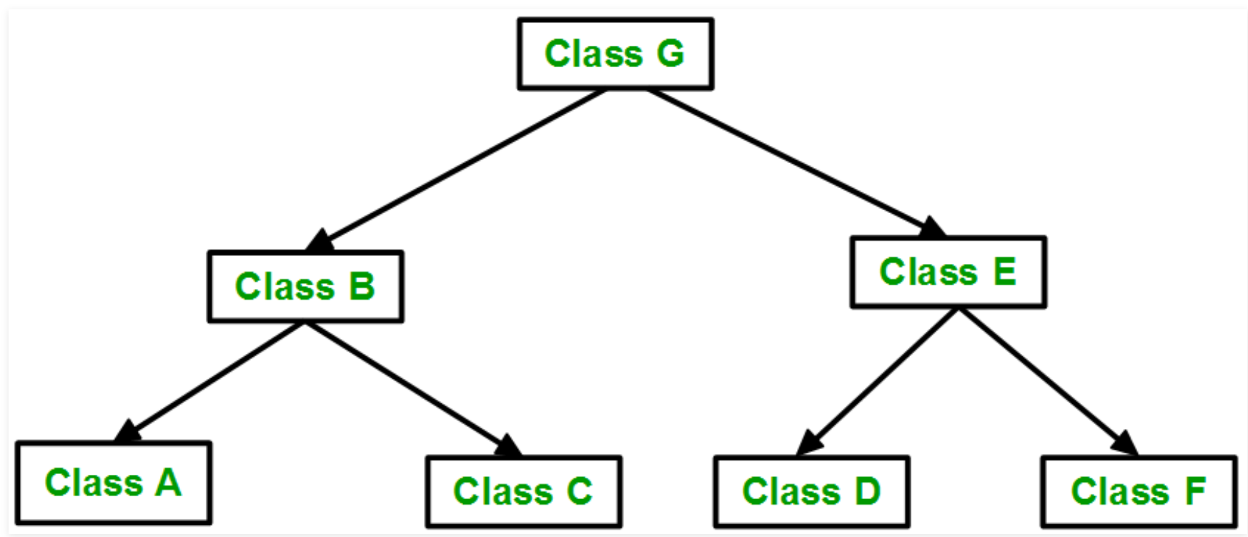
Inheritance - Types https://stackify.com/oop-concepts-c-sharp/#:~:text= https://en.wikipedia.org/wiki/Inheritance_(object-oriented_programming) https://www.geeksforgeeks.org/inheritance-in-c/
Hierarchical inheritance(C#) - where one class serves as a superclass (base class) for more than one sub class.

Slide 9
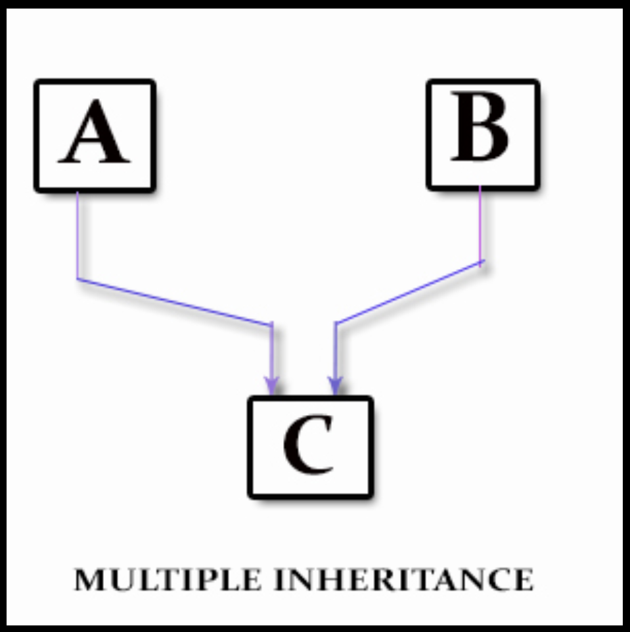
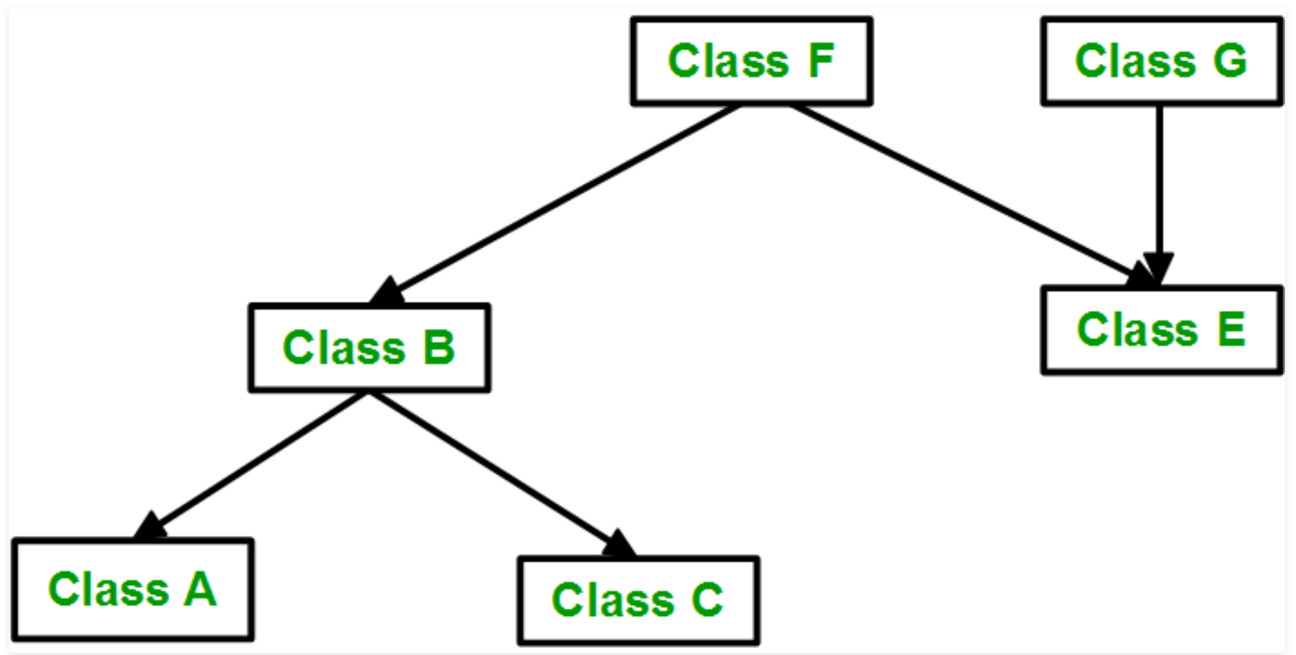
Inheritance - Types https://stackify.com/oop-concepts-c-sharp/#:~:text= https://en.wikipedia.org/wiki/Inheritance_(object-oriented_programming) https://www.geeksforgeeks.org/inheritance-in-c/
Multiple inheritance(NOT IN C#) - one class can have more than one superclass and inherit features from all parent classes.
Hybrid inheritance(NOT IN C#) - a mix of two or more types of inheritance.
NOT IN C#

Slide 10
Inheritance and Access Modifiers https://docs.microsoft.com/en-us/dotnet/csharp/tutorials/inheritance#:~:text=
Access Modifiers affect inheritance
Protected - visible only in derived classes.
Internal - visible only in derived classes in the same assembly as the base class.
Public - visible in derived classes and are part of the derived class' public interface.
Members of a base class that are NOT inherited by derived classes.
Static constructors – Which initialize the static data of a class.
Instance constructors – Each class must define its own constructors.

Slide 11
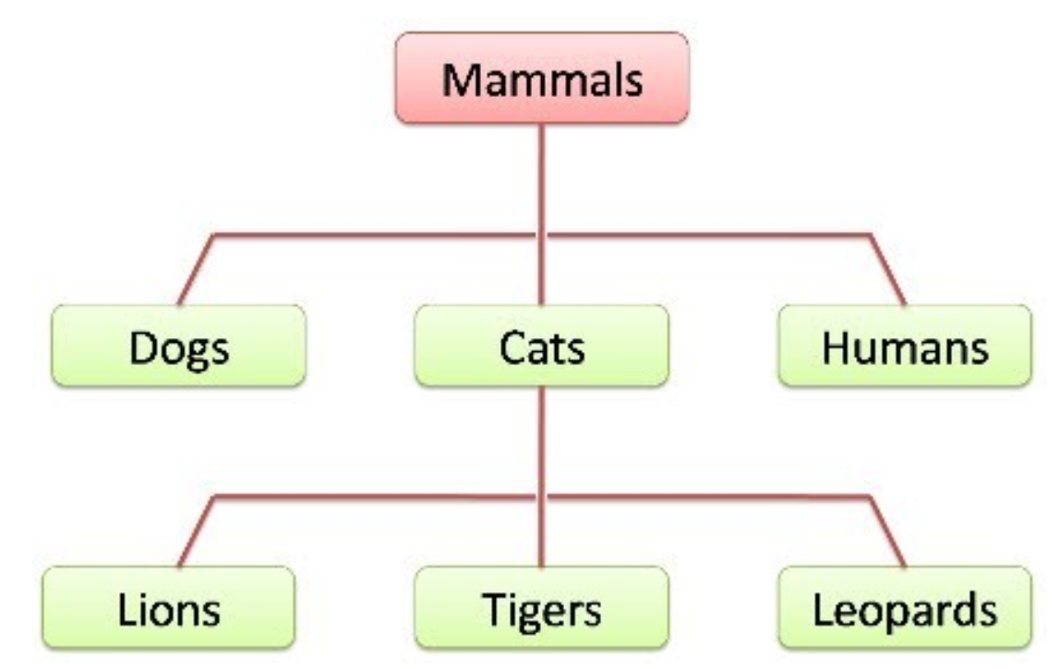
Inheritance – an ‘is a’ relationship https://docs.microsoft.com/en-us/dotnet/csharp/tutorials/inheritance#:~:text=
Inheritance is used to express an "is a" relationship between a base class and one or more derived classes, where the derived class ‘is a’ specialized version of the base class.
An ‘is-a’ relationship based on inheritance is best applied to add additional members to the base class or that require additional functionality not present in the base class.

Slide 12
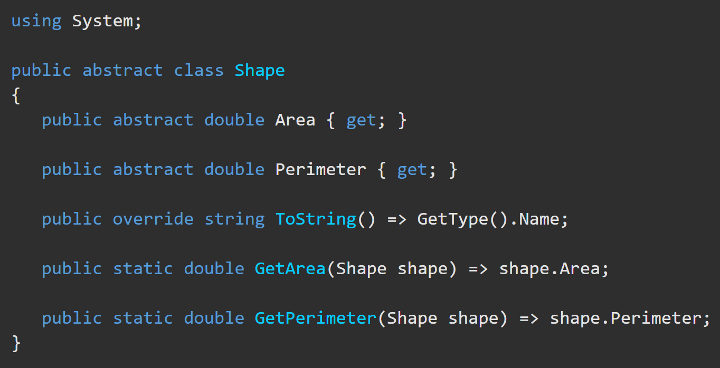
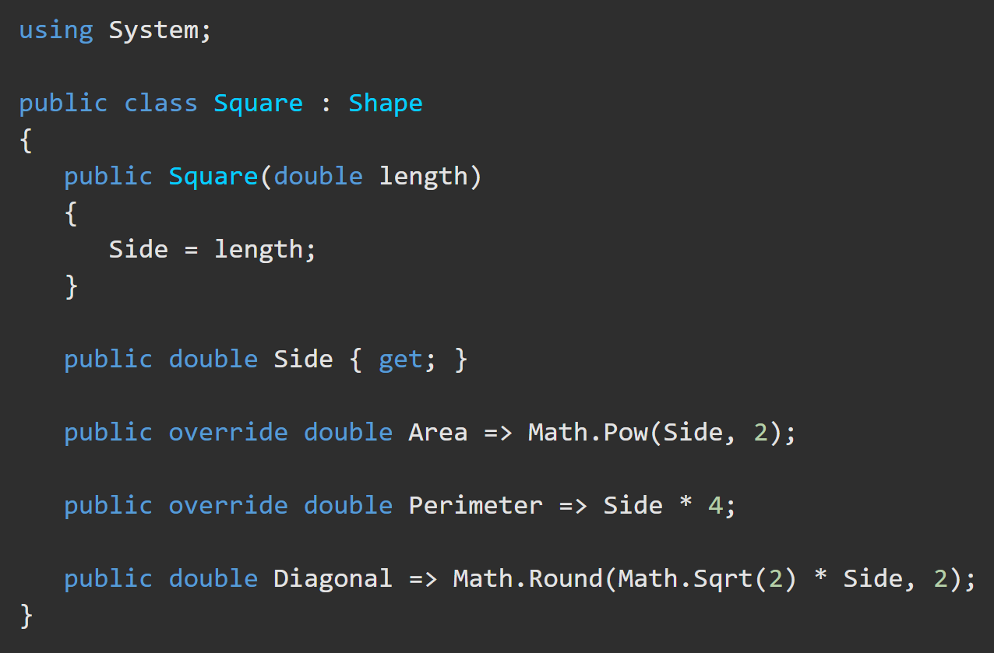
Polymorphism https://docs.microsoft.com/en-us/dotnet/csharp/tutorials/inheritance#designing-the-base-class-and-derived-classes
Polymorphism is when each derived class implements the same methods but in different ways.
If a base class member is marked abstract, it must be defined in the derived class.
Only virtual base class members may be overridden.
Only derived class members using the override keyword may implement an alternative definition of the virtual base class member.

Slide 13
Activity
Complete the implementation of the Publication => Book program.

